Slide 1

Scholarship for needy Students
80% students in the institute are from rural background with farming as a main occupation in most of the case.
Merit-based scholarships to support economically weaker students.
Reduce the financial burden on students and their families
Currently, Siemens, Cummins, Samarth, and Emerson companies are providing partial support to approximately 20-25 students.
However, the requirement greatly out-numbers the need
Will Support Tuition and mess fees
Named Scholarship against your father/ mother or loved once.
Can interact with beneficiary student and receive a thank you note from him/ her
Funds Required for Scholarship- 1 Cr
(Approximately will cover 150 students for a year)

Slide 2

Student Research Project
Financial constraints limiting research projects
Funds are required to buy/ build parts required for working on Btech and Mtech research project
Travel grants to present research papers Nationally and Internationally
Bridge funding gaps and drive cutting-edge research and opportunities for hands-on research experiences
Enhances critical thinking, problem-solving skills, and overall academic growth
Encouraging research and promote innovation and technological advancements.
Benefits:
Research to advance work on an issue/project
Develop the skills and experience required to work in a real job
Research projects will engage students in real-world problem-solving, potentially contributing to advancements in the respective fields.
Funds Required-
B.Tech - 15 Lakh for 1 Years
M.Tech - 10 Lakh for 1 Years

Slide 3
Improving Student Skills
Upskill students in key high-demand areas such as Thermodynamics, Material Science, Structural Analysis, Digital Signal Processing, Microcontrollers and Embedded Systems, artificial intelligence, cloud computing, web design, and digital marketing through courses
Grooming session for spoken English , Aptitude and improving coding skills
Sponsored lecture series for prominent speaks, Entrepreneurs from the industry to motivate and guide students
Laptop for needy students
Benefits :-
Develop recent technical skills required to work in a real job
Upskilling the students will boost employability
Enhanced Communication will increase confidence and open new opportunities Workshops, seminars, and skill development programs will equip students with industry-relevant skills, making them valuable assets in the workforce.
Funds Required-
Upskilling - 12 Lakh for 1 Years
Laptops - 30 Lakh for 1 Years (around 40 students)

Slide 4
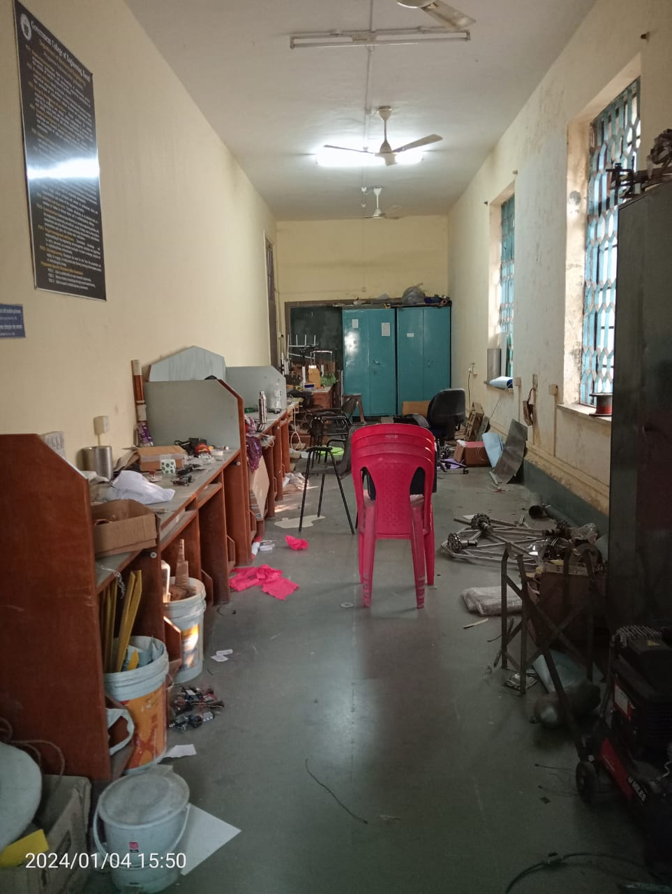
4. Microfactory and Tinkerer’s Lab
What is Microfactory? A micro-factory is a small manufacturing set up, self-sufficient to manufacture and assemble small objects/devices involving mechanical, electrical, electronics, sensing, actuating, positioning devices using mechanical, 3D, laser processes using metals, polymers, wood cloth etc. The primary purpose of micro-factories is for manufacturing small assemblies.
The primary purpose of Tinkerer’s Lab is for manufacturing small Prototypes And Transforming these ideas into business Ventures.
Product prototypes students build here will not be bound by any syllabus through imaginative ideas and creative talent
Benefits :-
Innovation and hands-on learning
Prototyping and Small-scale Production
Tiny steps taken towards becoming successful entrepreneurs
Potential collaboration with industries and startups
Impact on student creativity, practical problem-solving and entrepreneurship
Students will get access to advanced technology and tools and get confidence by the ‘learning by doing’
Current Student Lab
Funds Required- 1 Cr

Slide 5
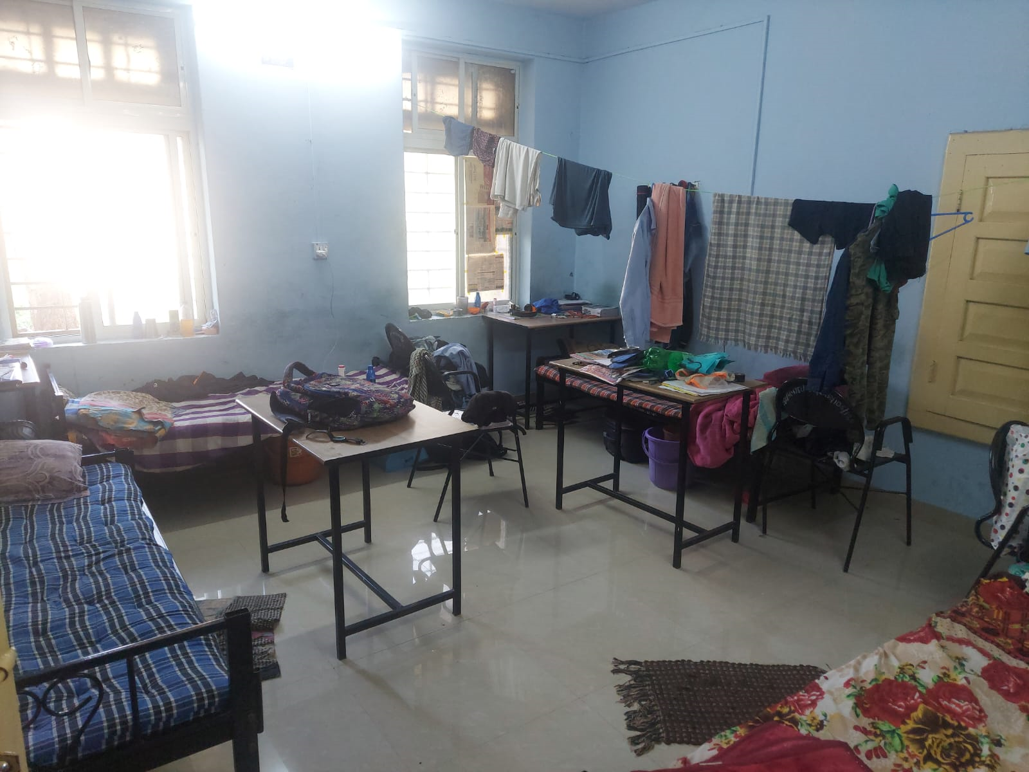
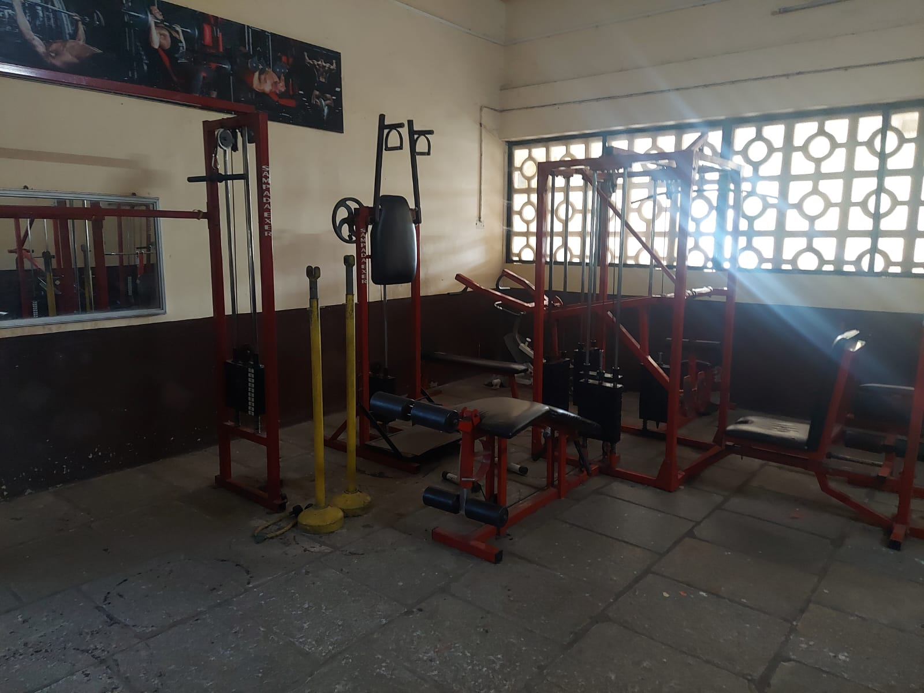
5. Hostel and Gym Renovation Fund
Upgrading living and recreational spaces is essential for the overall well-being of students. Since Hostels have been there for 50+ years, they require proper maintenance.
Deteriorating conditions: leaky roofs, outdated facilities
Four students in one room
Lake of equipment's in the gym
Benefits
Improve infrastructure, safety, and overall living conditions.
Create a more conducive environment for current and future students.
Address specific issues like infrastructure decay, safety concerns, and outdated amenities
Lasting symbol of alumni commitment to the hostel's future
Actual Hostel Photos
Funds Required- 1.5 Cr

Slide 6
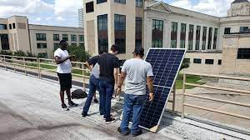
6. Sustainability - Use of Solar Energy in Campus
Institute is having streetlights in overall, operating on conventional power source.
Proposal is to convert all streetlights to solar operated lights
Installation of Solar panels on the top roofs of college buildings and having LED lights on campus
Proposed initiative will increase awareness to students for the use of green energy & sustainability agenda
Benefits :-
It’s a green energy boosting environment for students.
Save On electricity consumption for the institute
Image for representation purpose only
Funds Required- 50 Lakhs

Slide 7
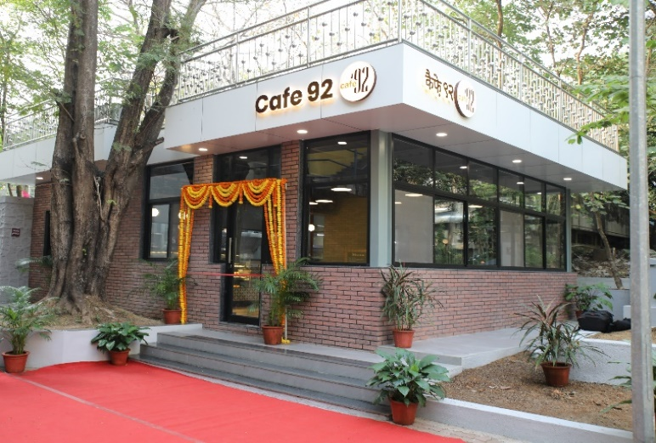
Cafeteria for Student
7. Cafeteria for Student
Students life on campus revolve around their classes, labs, hostels and eating joints in and around the campus. A place for a quick snack or to catch up with friends is always desirable.
Institute is having only one Canteen at present . Need Cafeteria at different locations.
It is essential for the students to have nutritious and hygienic food and refreshments at affordable prices
Should be open till 12.30 am and open at 6 am in the morning
The canteen would match the college standard
Benefits :-
Providing wholesome and quality food at reasonable price.
Maintaining a good ambience and good aesthetics of the canteen.
Creating an attractive and different menu to cater the nutritional needs of the students.
Image for representation purpose only
Funds Required- 60 Lakhs

Slide 8
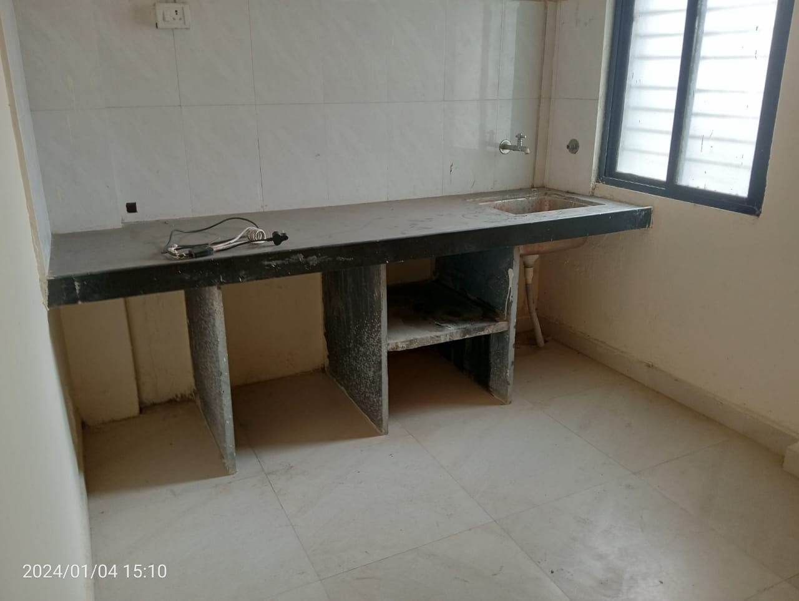
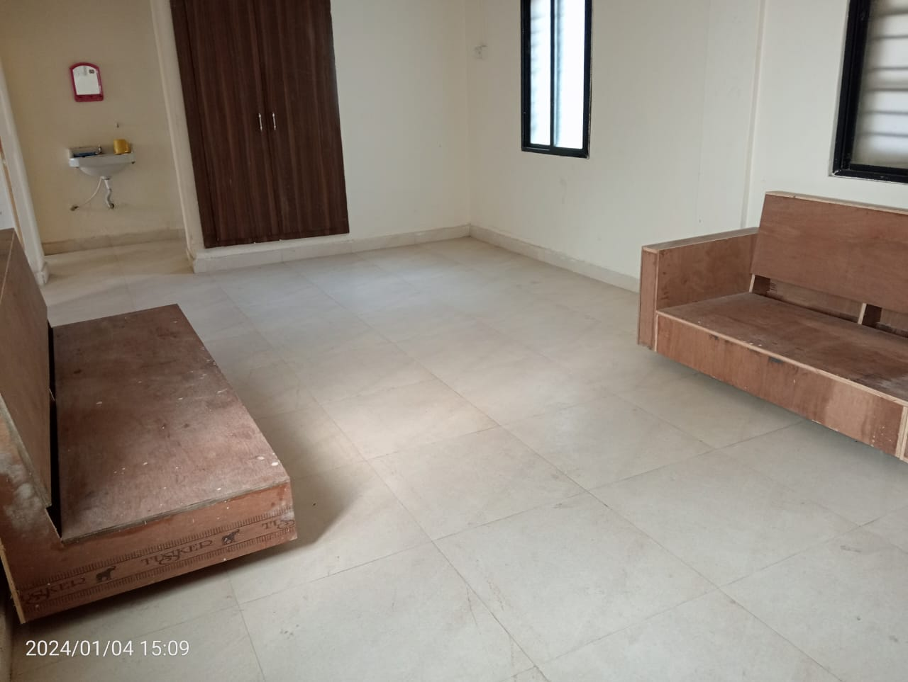
8. Modernization of Guest House
Current Scenario:
Institute have 3 Guest Rooms with very basic amenities like cot, table, chair, cupboard in their rooms. The rooms are spacious, airy, and illuminated with green surrounding.
Need to furnished with many required facilities.
Time to time renovation and House keeping.
Benefits :-
Improved Facilities for Alumni and Visitors comfortable and inviting space for them to stay during visits.
Alumni are more likely to engage (strengthening connection)with the college and participate in events when they feel welcomed and accommodated
Positive Impression on Visitors, Potential Students and Partners, reflects positively on the overall image of the college
Make college an attractive venue for alumni gatherings, reunions, and events.
Can attract a broader range of guests, including prominent alumni, conference attendees and spokespersons
Funds Required- 25 Lakhs
Actual Guest House Photos

Slide 9
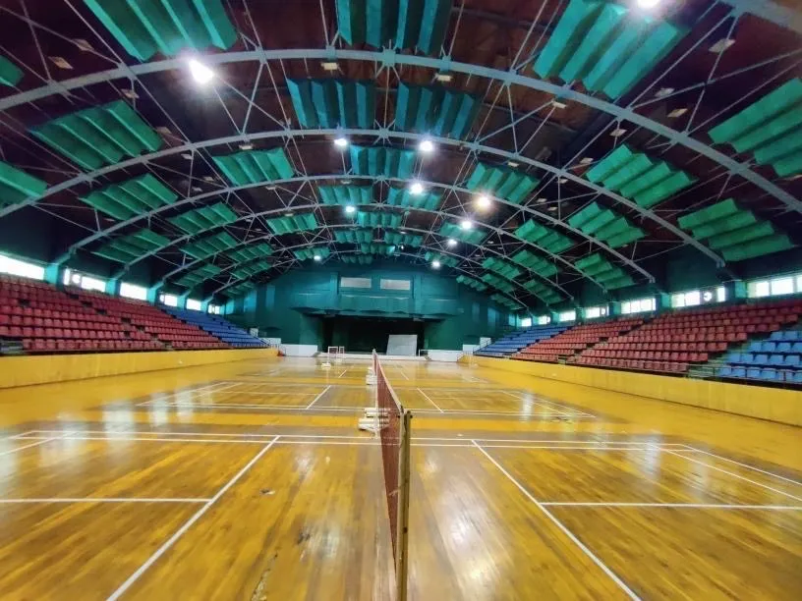
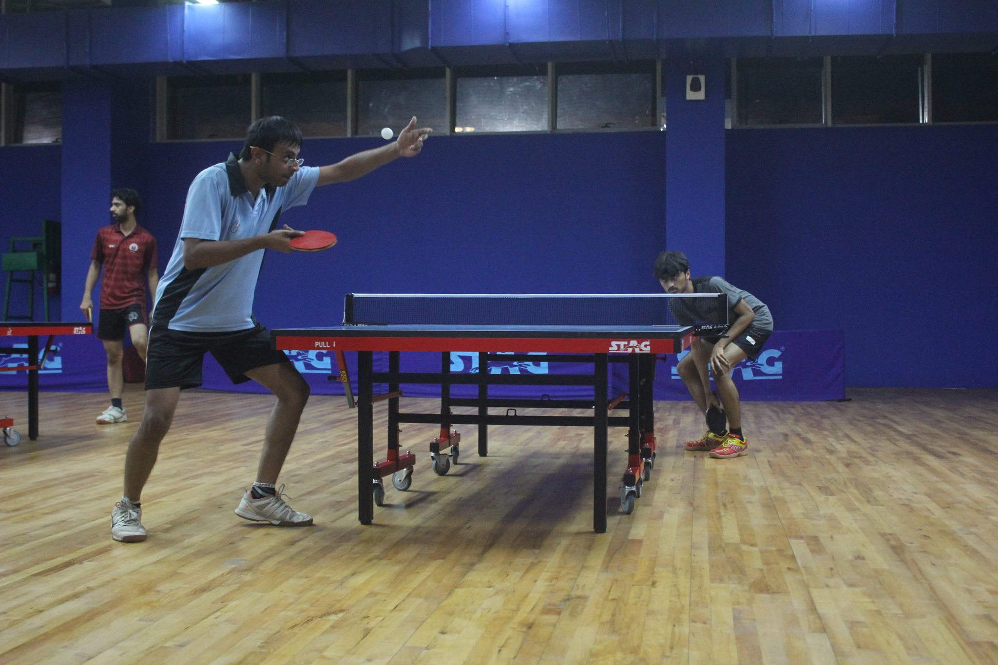
9. New Gymkhana facility for boys and girls
Regular physical activity is one of the most important things you can do for your health. Being physically active can improve your brain health, help manage weight, reduce the risk of disease, strengthen bones and muscles, and improve your ability to do everyday activities
New Gymkhana with all facilities is required for both girls and boys in campus.
It is expected to house Indoor Badminton Court, Table tennis and Gymnasium instruments
Benefits :-
Encourages young students to choose to be physically active and aware of the benefits.
Improves academic performance.
Promote a healthy and balanced lifestyle
Image for representation purpose only
Funds Required- 10 Cr

Slide 10
10. Occupational Mental Health Care
A website will be designed for students who need mental support and issues will be handled by physicist visiting campus twice a month.
It is created to educate the students about mental illness, raise awareness surrounding research and treatments, reduce the stigma associated with mental illness, and celebrate recovery from it.
Because of misconceptions and stigma surrounding mental health issues, people often suffer in silence and don’t seek treatment for their conditions.
Physical Health and Mental health counselling and treatment is good to have in the Institute
Benefits :-
It’s provide mental support to students coming from rural background, having low confidence and susceptible to depression.
Intangible benefit of Improvement in Placement by 20% .
Funds Required- 5 to 10 lakhs a year

Slide 11
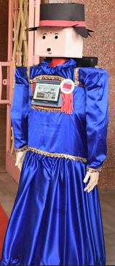
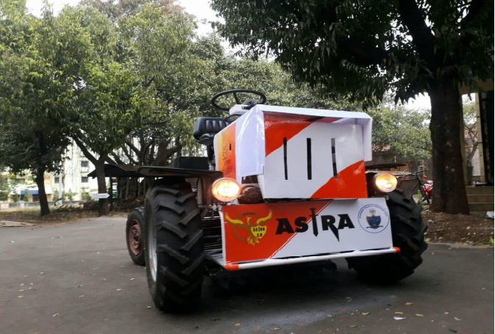
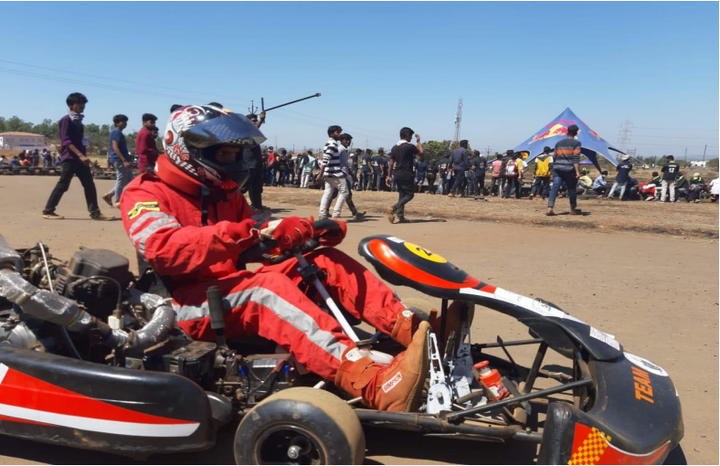
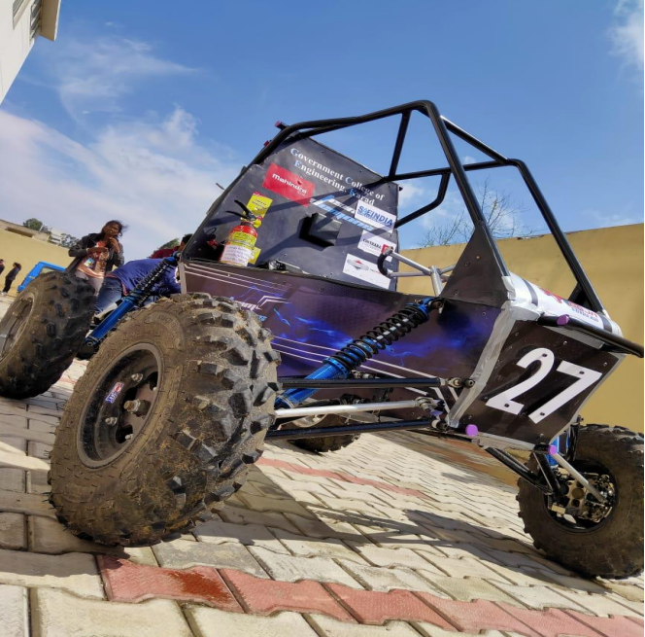
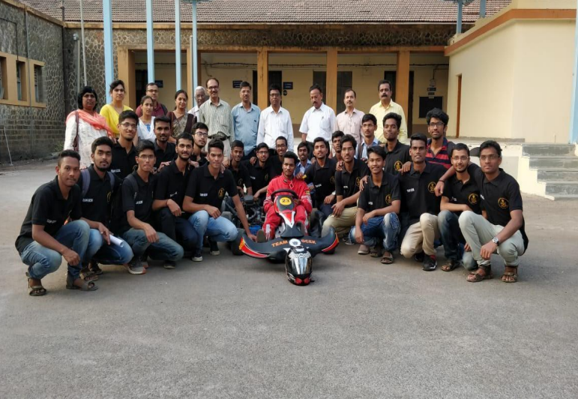
11. Student Led Project
RoboClub: Fostering Robotics Excellence
EffiCycle: Design and fabricate an energy efficient
entirely human powered three-wheeled vehicle
Pratham Car: Driving Innovation in Automotive
BAJA 2K22: Car designed to run on difficult terrain
Every year teams add new feature to these models for better version
Funds are required for building/ fabricating new parts
Contributions fueling these groundbreaking projects
Shape the future of technology and innovation
Students design, fabricate and validate these vehicles to take part in the series of events spread over a course of a 4 days that test the vehicle for sound engineering practices that have gone into it. The agility in terms of gradeability, speed, acceleration and ranked every year
Funds required 6 Lakhs a year
Benefits :-
Actual Photos

